Slide 1
Travel, Tourism and Hospitality

Slide 2
Contents
Introduction
About business system
About field study
Form
Personas
Customer Journey Maps
Empathy Maps
Affinity Diagram
User Stories
Conclusion

Slide 3
Introduction
The industry of travel and hospitality is witnessing massive changes and high competition. The sector has a very challenging and complex operational environment. The industry demands superlative customer experience and companies in this business strive hard to achieve customer loyalty and their following. Customers today want customized travel experiences and demand best levels of service. The customers can always choose from many options and go for the one that provides them better experience at a price lower than competition.
As part of the field study, we have interviewed several users who are constantly in need of better websites in the field and collected some insights based on them

Slide 4
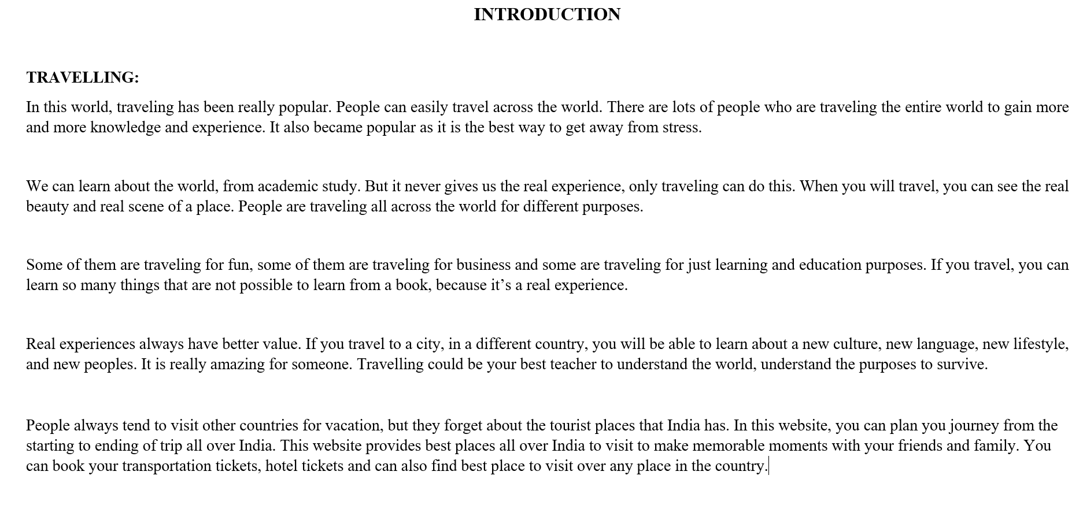

Slide 5
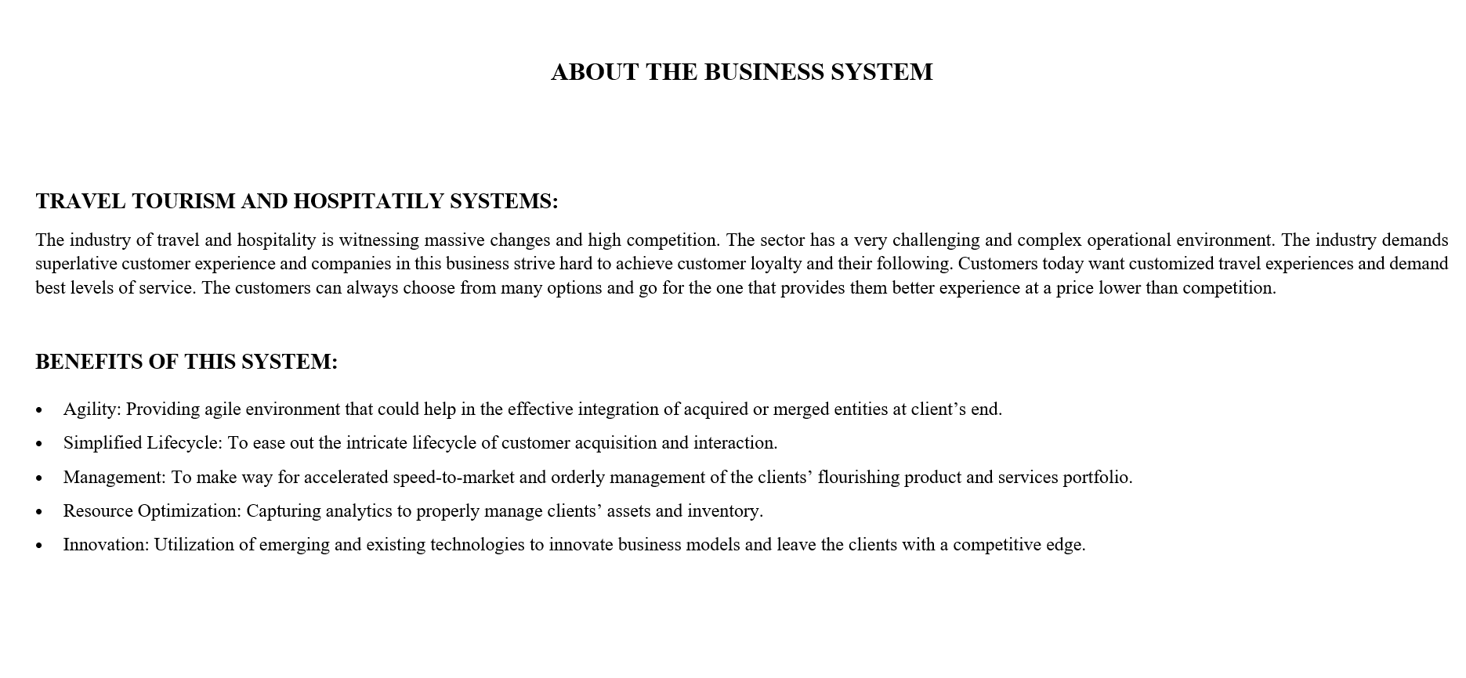

Slide 6
About Field Study
Firstly, we have visited online websites and got an overview of our business system in the project. After that we have conducted a field study related to our business system by conducting surveys through forms and interviews. Through these surveys we collected many pros and cons for the existing websites. We have gathered common issues that people face while traveling and the problems they have faced with accommodation and hospitality. Then we have extracted persons, journey maps, empathy maps, affinity diagram which explains their emotions in a detailed manner. We have described the user stories which describe types of users using the business systems. We have crafted all our findings creatively in a LinkedIn article.

Slide 7
Form
https://docs.google.com/forms/d/1W2yyNUZTIsiw3GYl0oxUgUISA40l7tmIcxkgNUGH_ZI/edit#responses

Slide 8
User Personas
User centered design of his ideologies and usage of business system

Slide 9
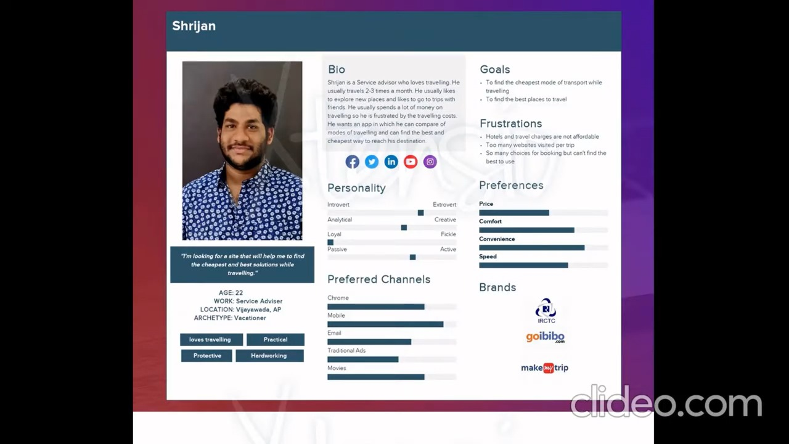

Slide 10
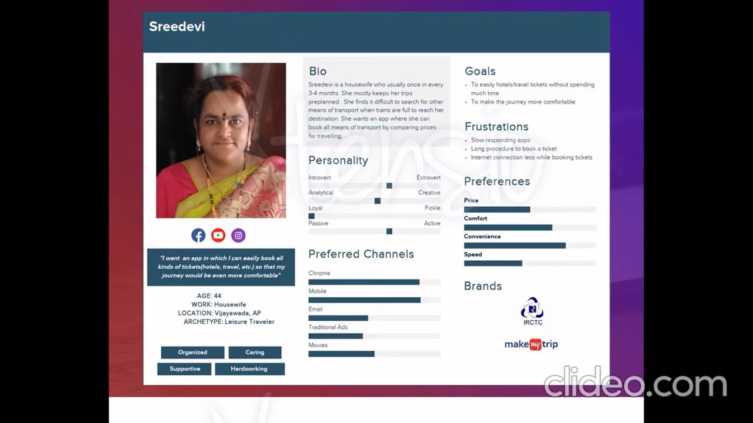

Slide 11
Customer Journey Maps
Process of creating visual story of user interaction with business system

Slide 12
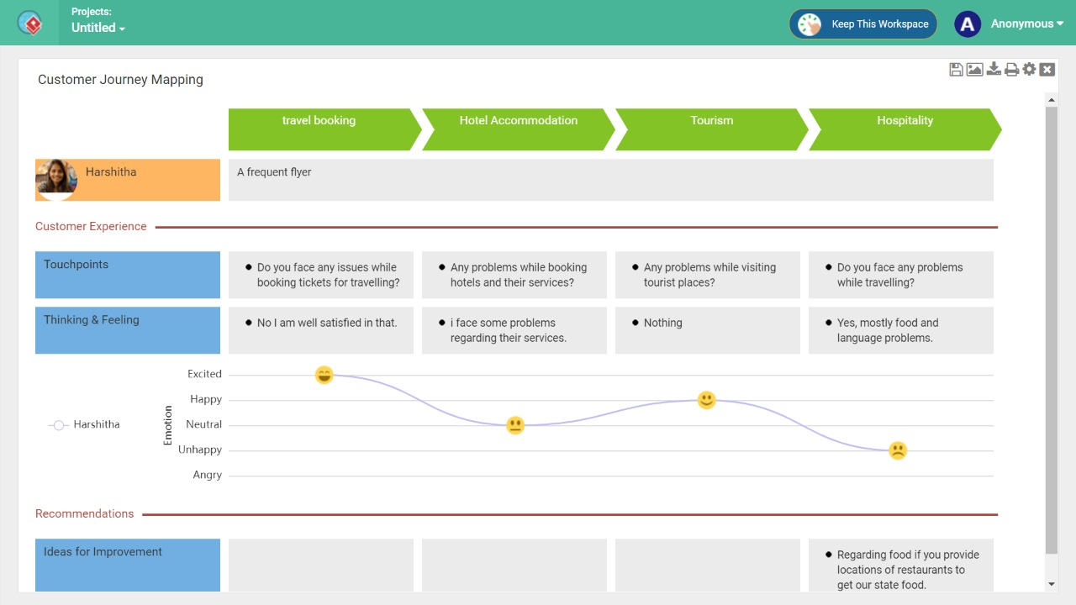

Slide 13
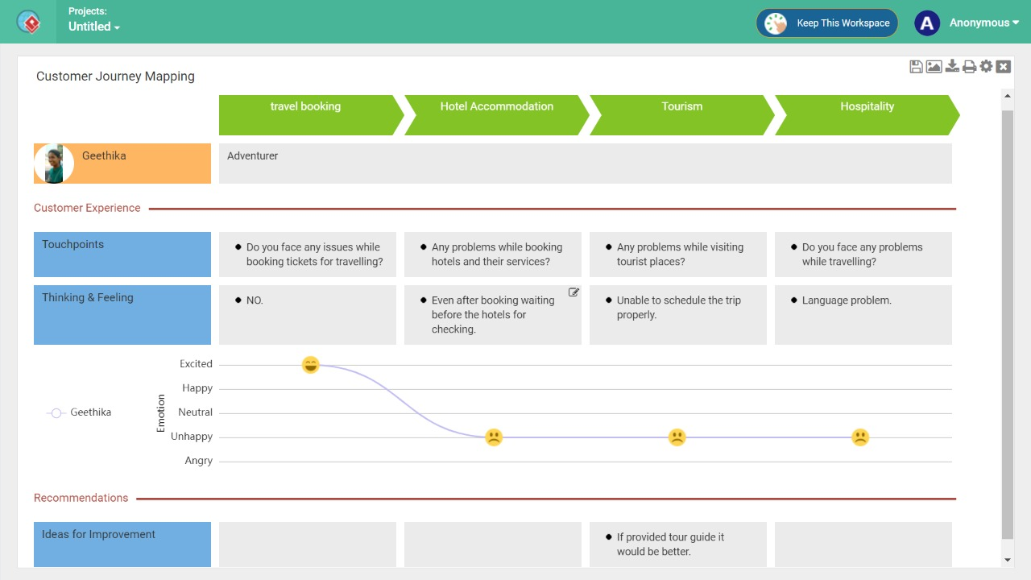

Slide 14
Empathy Maps
Captures user behavior and attitude towards business system

Slide 15
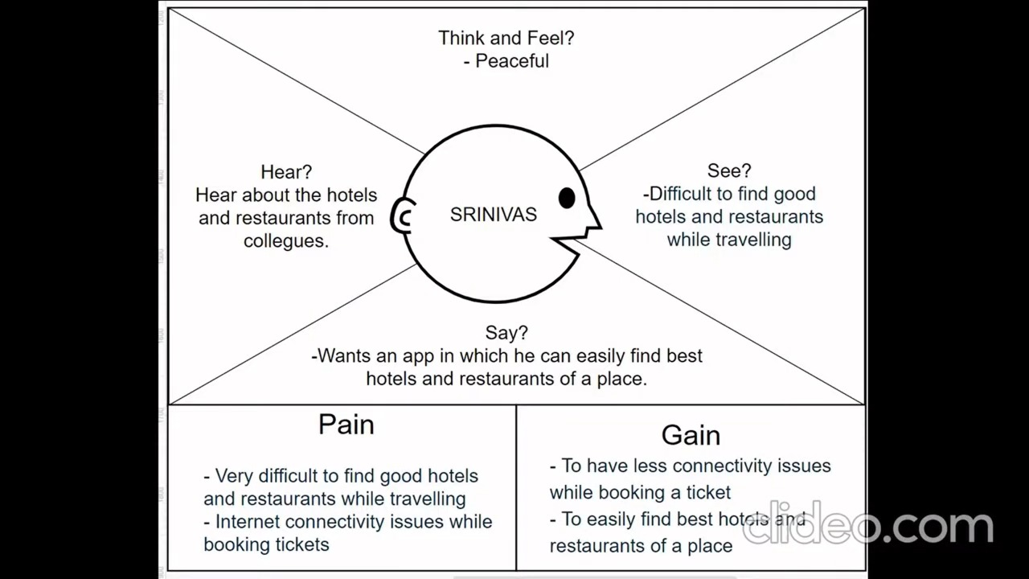

Slide 16
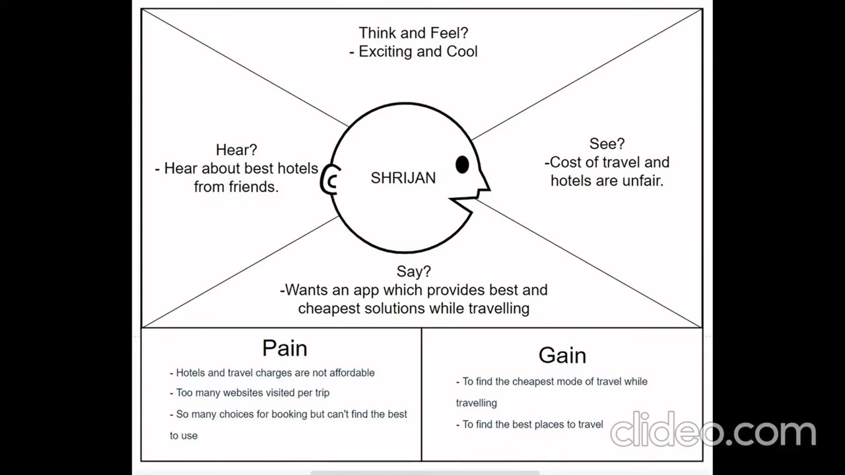

Slide 17
Affinity Diagram
Grouping all our ideas according to their similarity usually from a brainstorming session

Slide 18
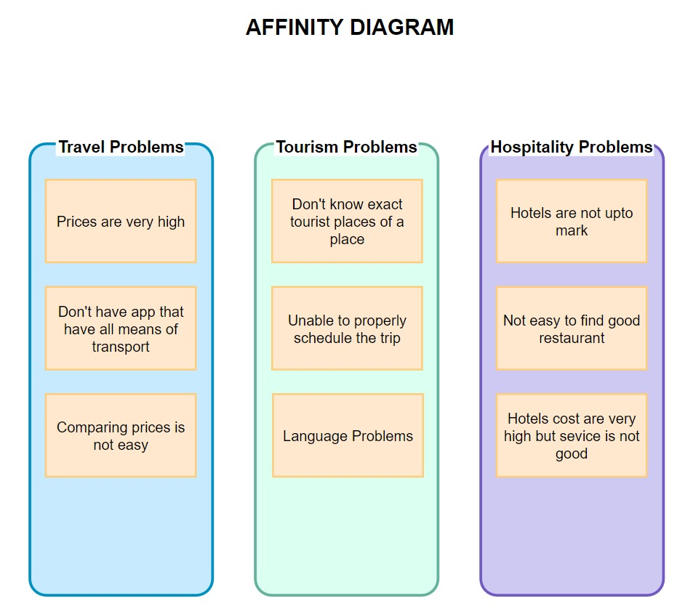

Slide 19
User Stories
Description of business system from end user's perspective

Slide 20
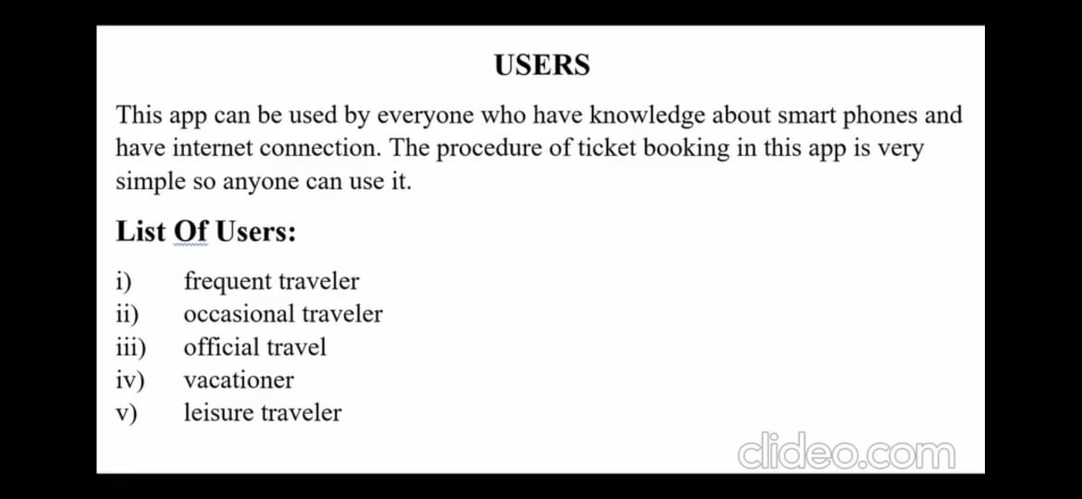

Slide 21
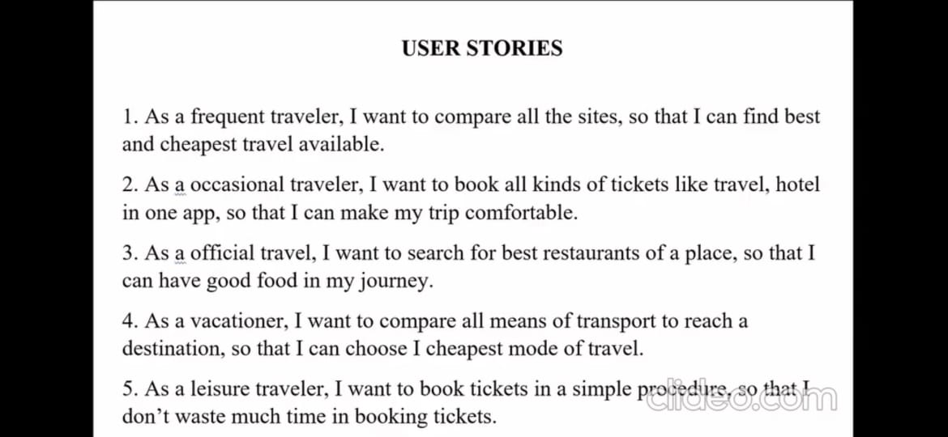

Slide 22
Concepts Used
Mathematical programming- providing best and cheapest solution
Data science - providing travel support bot
Technical skills- Django for preparing frontend and backend

Slide 23
Conclusion
This presentation describes all the user diagrams we have included as part of our user research and field study. All the user diagrams here describes the user views on the business system and how they have responded in the field study we have conducted.

Slide 24
Thank You

